Slide 1
MyBlog -- One stop destination for information
-Nandha Krishna (3122215002)
-Sherwin Antony (3122215002)
-Vigneswaran (3122215002)
-Vinay Choudhary (3122215002129)

Slide 2
Problem Description
Develop a comprehensive blog platform that empowers users to register, create, and publish blog posts seamlessly. This platform should include robust features such as a rich text editor to enhance the writing experience, and the ability to categorize and tag posts for better organization and discoverability. Additionally, incorporate a commenting system to facilitate reader engagement and interaction with authors. To ensure content accessibility and reach, provide responsive feed support for automatic updates. The platform should prioritize user-friendliness, enabling bloggers of all skill levels to create and share content effortlessly, while also offering readers a dynamic and engaging way to consume information. This solution aims to foster a vibrant community of writers and readers, enhancing the overall blogging experience.

Slide 3
Functional Requirements
User Registration and Authentication
Users must be able to register an account with email and password.
Users must be able to log in and log out securely.
Password recovery and reset functionality should be available.
Blog Post Creation and Management
Users should be able to create, edit, and delete their blog posts.
Include a rich text editor with features like text formatting, image and video embedding, and hyperlinking.
Users should be able to save drafts of their posts.
Categorization and Tagging
Users must be able to categorize their blog posts.
Users should be able to add tags to their posts for better discoverability.

Slide 4
Functional Requirements
4. Commenting System
Users should be able to comment on blog posts.
Authors should be able to moderate comments (approve, delete, and reply to comments).
5. Responsive Feed
Provide a responsive feed that updates automatically with new posts.
Ensure the feed supports various devices (mobile, tablet, desktop).
6. Search and Discoverability
Implement a search function to find blog posts by keywords, categories, or tags.
Display related posts for each blog entry to keep readers engaged.
7. User Interaction and Engagement
Enable users to like and share posts on social media.
Provide a mechanism for users to follow other authors and receive updates on new posts.

Slide 5
Non Functional Requirements
Performance
The platform should load quickly and handle a large number of users and posts efficiently.
Optimize database queries to ensure fast retrieval of blog posts and comments.
Scalability
The platform should be able to scale horizontally to accommodate growing user numbers and content volume.
Use scalable infrastructure (e.g., cloud services) to support increased traffic.
Security
Ensure data encryption for user information and secure authentication mechanisms.
Implement protection against common web vulnerabilities (e.g., XSS, CSRF, SQL injection).
Compatibility
Ensure the platform works across different web browsers and devices.
Provide consistent user experience on various screen sizes and resolutions.

Slide 6
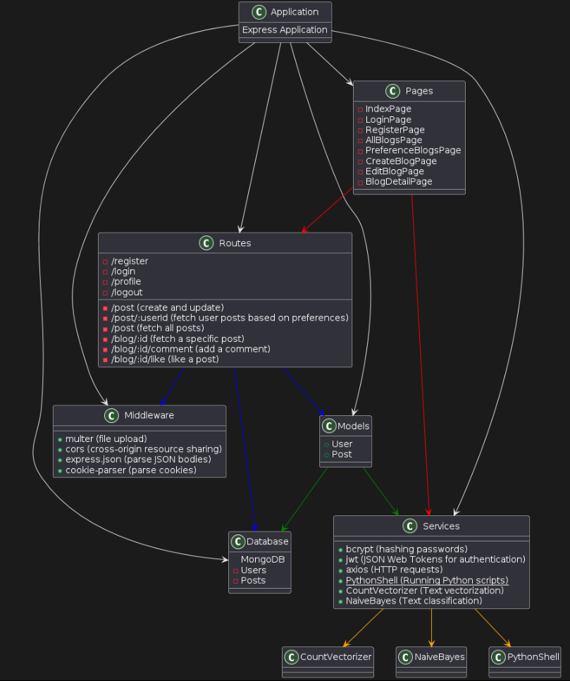
Class Diagram

Slide 7
Tools Used
Frontend:
React: A JavaScript library for building user interfaces.
React Router: For handling routing in the application.
Context API: For state management across the application.
CSS: For styling the application components.
Backend:
Node.js: A JavaScript runtime built on Chrome's V8 JavaScript engine.
Express.js: A web application framework for Node.js to build RESTful APIs.
Database:
MongoDB: A NoSQL database for storing user information and blog posts.
Libraries:
axios: For making HTTP requests from the frontend to the backend.
date-fns: For formatting dates in JavaScript.
Development Tools:
Visual Studio Code: A code editor for developing the application.
Postman: For testing and documenting APIs.
Git: For version control and collaboration.

Slide 8
Algorithm Used
Naive Bayes algorithm was implemented in conjunction with CountVectorizer for categorizing blog posts.
This approach capitalized on the probabilistic nature of Naive Bayes to facilitate efficient text classification, operating under the assumption of feature independence.
CountVectorizer converts textual data into numerical features, thereby preserving word frequency information essential for classification. Preprocessing steps, such as removing punctuation and stopwords, were implemented to ensure the integrity of the input data. Successful automation of the categorization process was achieved by training the Naive Bayes model on labeled dataset .
This integrated approach yielded a robust and interpretable solution for organizing blog content, ultimately enhancing user experience through improved navigation and content discovery.

Slide 9
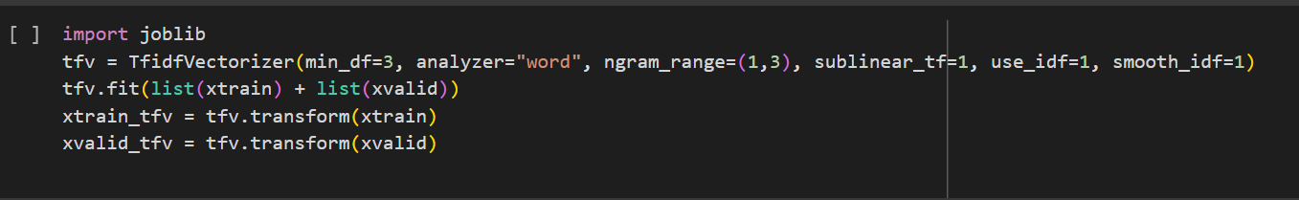
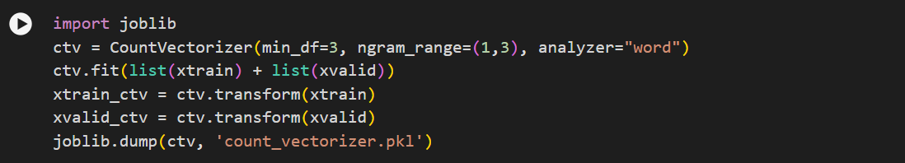
Code Snippets

Slide 10
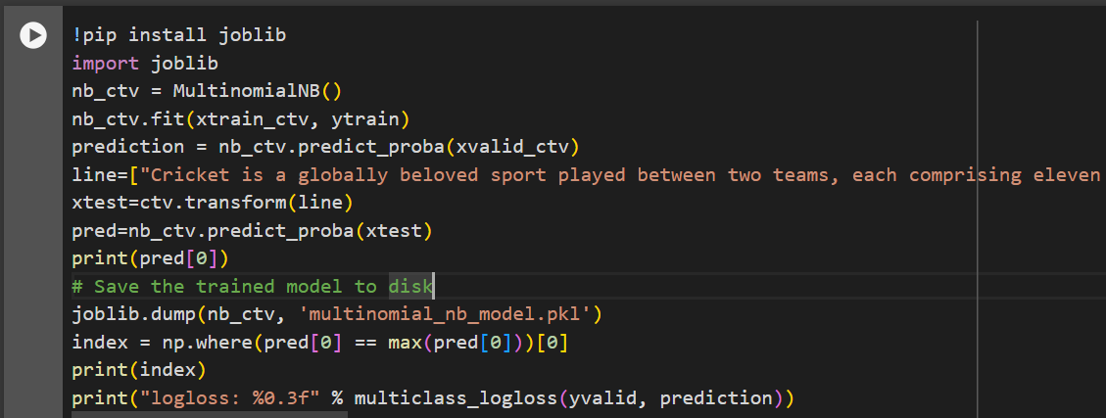
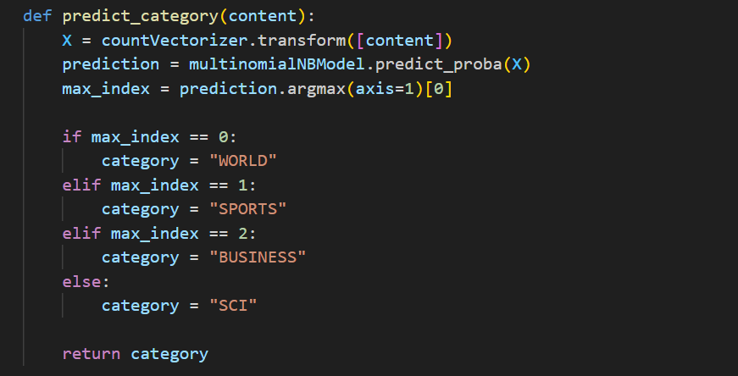

Slide 11
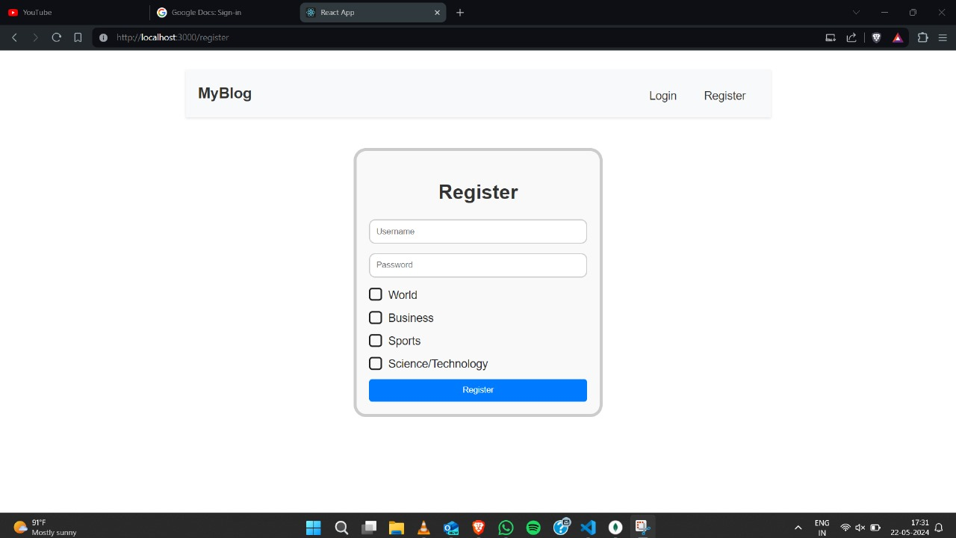
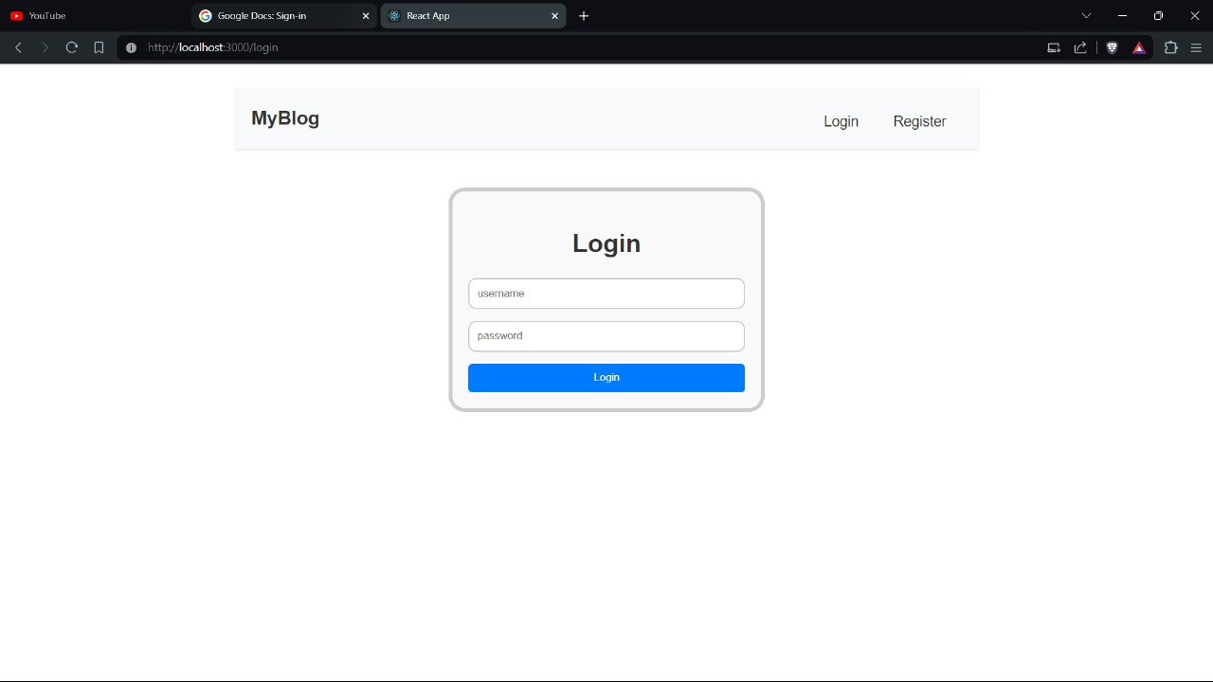
Signup and Login Page

Slide 12
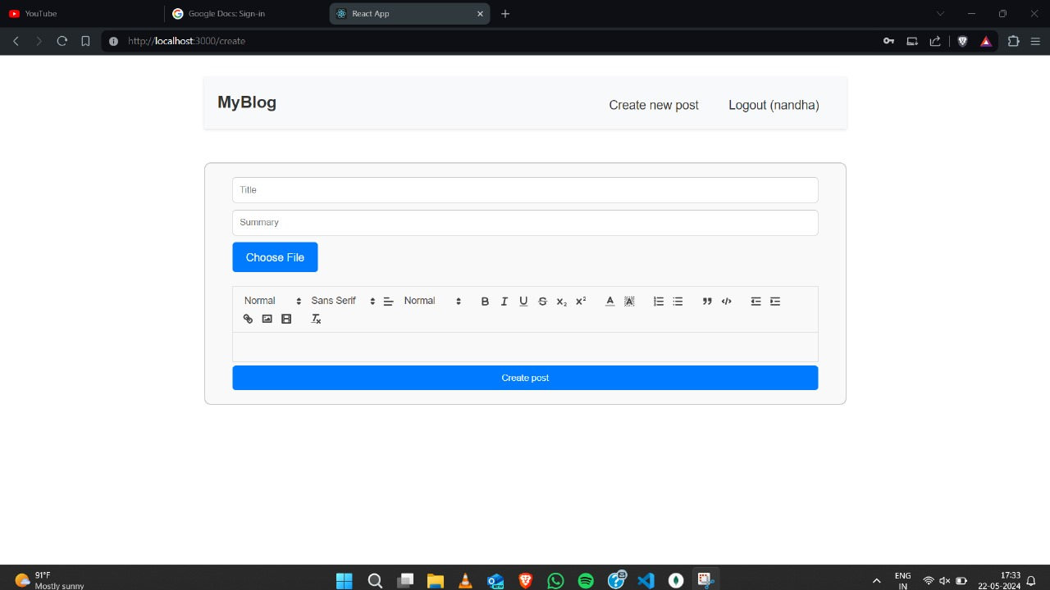
Blog Creation Page

Slide 13
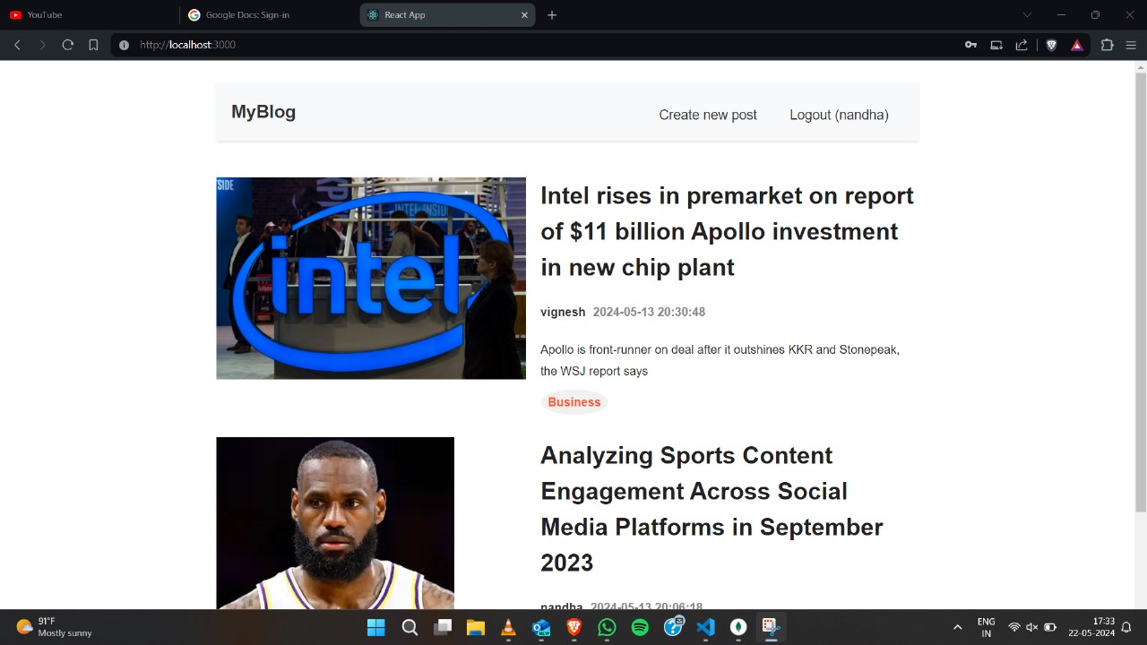
Dashboard

Slide 14
User Related Limitations
User Profile Verification:
While our platform simplifies the user profile creation process for ease of access, this means there is currently limited verification of user identities. This approach prioritizes user convenience but may occasionally result in anonymous postings.
Content Verification:
Our platform emphasizes user freedom in publishing content. However, this means we do not have extensive verification processes in place for every post, which can sometimes lead to the sharing of inaccurate or misleading information.
Handling Large Data Responsively:
To ensure a seamless experience, we are continually working on improving our infrastructure. However, during periods of exceptionally high traffic, users might occasionally experience slower performance as we refine our systems to handle large data volumes more effectively.

Slide 15
User Related Limitations
4. Plagiarism Check:
While we encourage originality and creativity, we currently have limited automated plagiarism checks. This means users need to be vigilant in ensuring their content is original to avoid unintentional duplication.
5. Defamation:
Our platform supports open and free expression, but this also means that without moderation, there is a potential for users to post harmful or false statements. We are exploring ways to enhance our moderation capabilities to foster a positive community.
6. Copyright Infringement:
We aim to respect intellectual property rights, but our current verification processes for copyright compliance are limited. Users should be careful to ensure that their content does not infringe on existing copyrights.

Slide 16
Developer Related Limitations
Scalability and Performance:
Backend Load and ML Model Efficiency: As the platform grows, it must handle increased traffic and database queries efficiently. Scalability is essential to ensure that both the backend infrastructure and ML models can manage larger datasets and higher request volumes without performance degradation. This may involve using more powerful hardware or optimizing algorithms.
User Experience Optimization: Maintaining a balance between a user-friendly interface and advanced features is crucial. The platform should ensure smooth performance and fast load times across different devices and network conditions, while keeping the UI intuitive and accessible to users of varying technical skills.
Data Privacy and Model Integrity:
Data Protection and Compliance: Safeguarding user data through robust encryption and access controls is vital but can be complex and resource-intensive. Adhering to regulations like GDPR or CCPA is essential to ensure legal compliance and build user trust, impacting how data is collected, stored, and processed.
ML Model Accuracy and Fairness: The quality and diversity of training data are critical for ML model effectiveness. Continuous improvement through regular updates and retraining is necessary to maintain accuracy and fairness, requiring a reliable pipeline for data collection, cleaning, and evaluation.

Slide 17
Future Scope
Social Media Integration: Allow users to share their blog posts seamlessly on popular social media platforms, expanding their reach and driving traffic to the blog platform.
Mobile Application: Develop a mobile application for the blog platform, allowing users to create, publish, and interact with content on the go, enhancing accessibility and user engagement.
Localization and Multilingual Support: Provide support for multiple languages and localization features to cater to a diverse user base, enabling bloggers from different regions to share their content in their native languages.
Community Building Tools: Introduce community-building features such as forums, groups, and events to foster collaboration, networking, and knowledge sharing among bloggers and readers.

Slide 18
Thank You

